Slide 1

Breast Cancer Classification Using LDA/QDA
Sean Cancino, Cancheng Ji, Jiexi Zhou

Slide 2
Outline
Data description
Methods:
Principal Component Analysis
Linear Discriminant Analysis
Quadratic Discriminant Analysis
Logistic Regression
Comparison

Slide 3
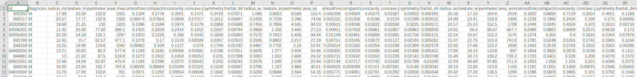
Data Description
Data Source: https://www.kaggle.com/uciml/breast-cancer-wisconsin-data and also https://archive.ics.uci.edu/ml/datasets/Breast+Cancer+Wisconsin+%28Diagnostic%29
Description: To predict whether the breast mass is malignant:
Attribute: Diagnosis (M=Malignant B=Benign)
Features: The mean, standard error and "worst" or largest of the 10 features: radius, texture, perimeter, area, smoothness, compactness, concavity, concave points, symmetry, fractal dimension
So there are 30 features
Notes:
Data slide

Slide 4
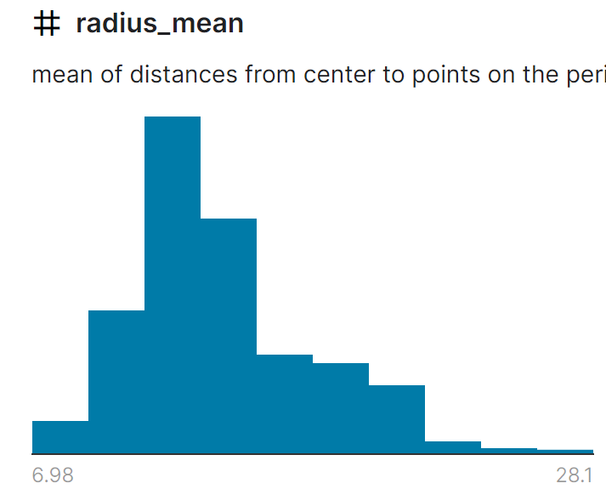
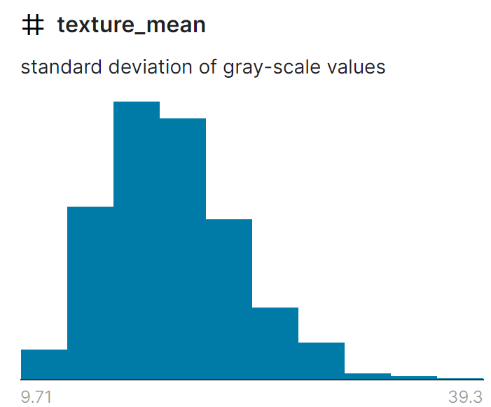
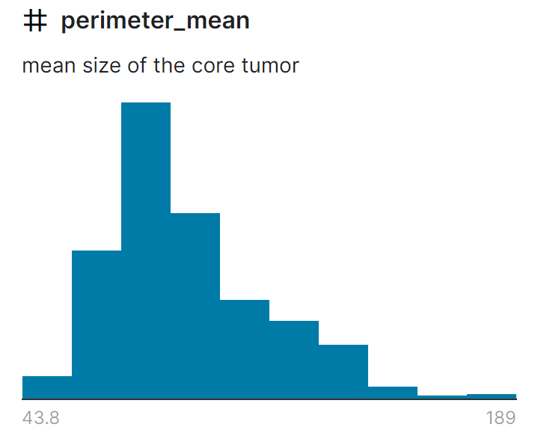
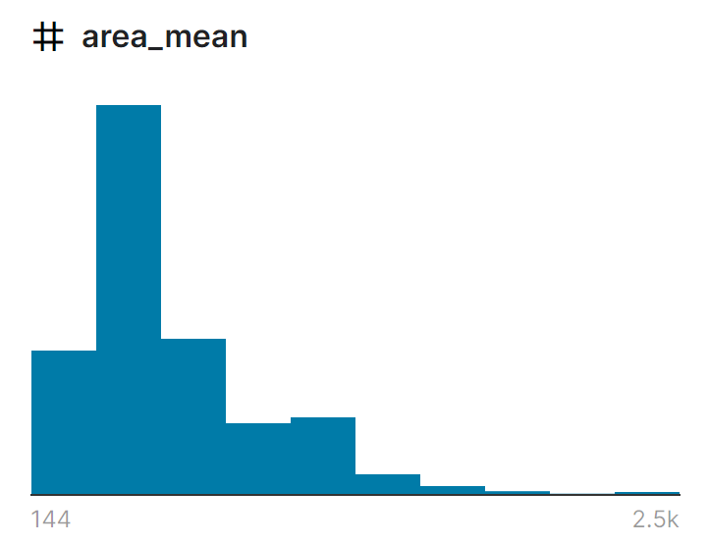
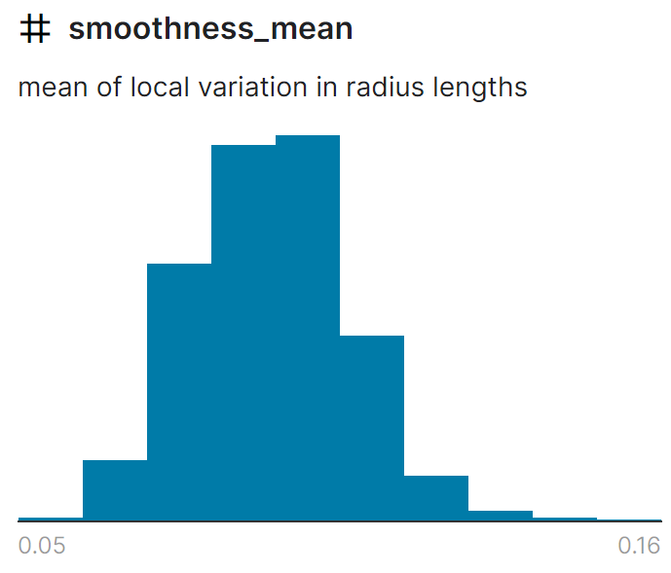
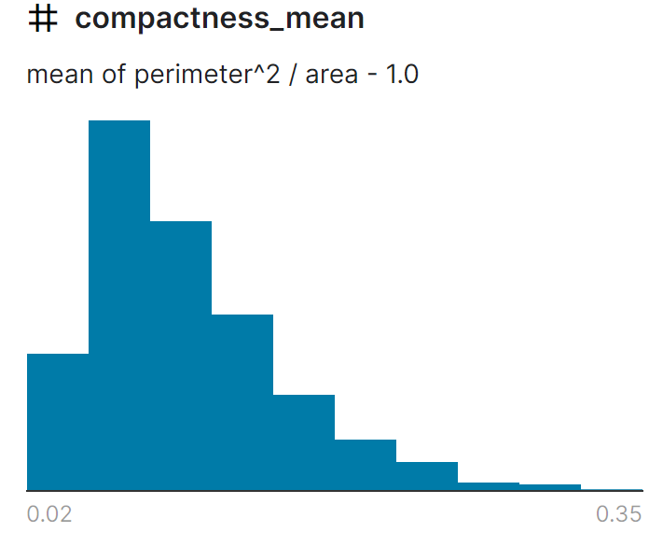
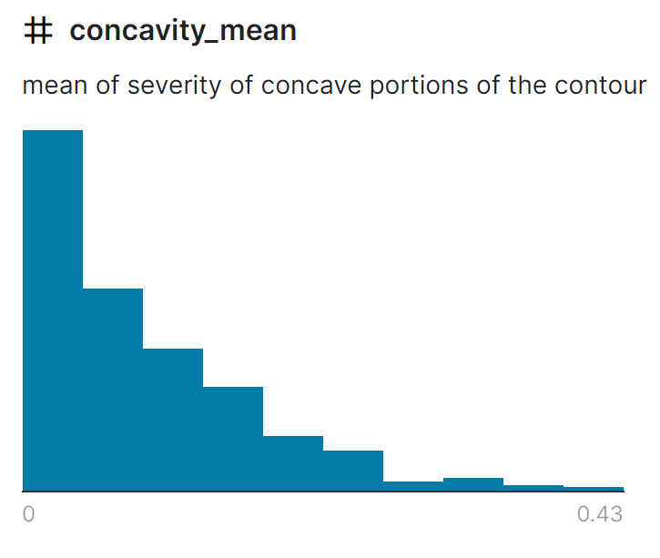
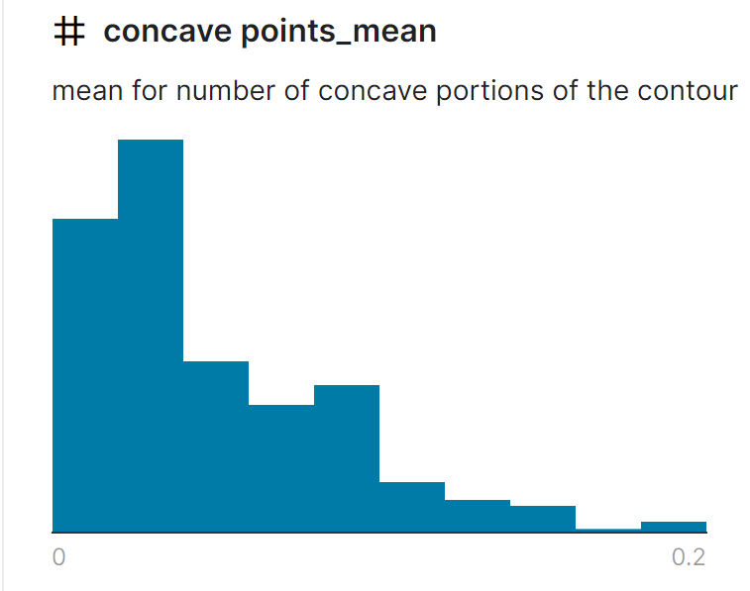
Normality

Slide 5
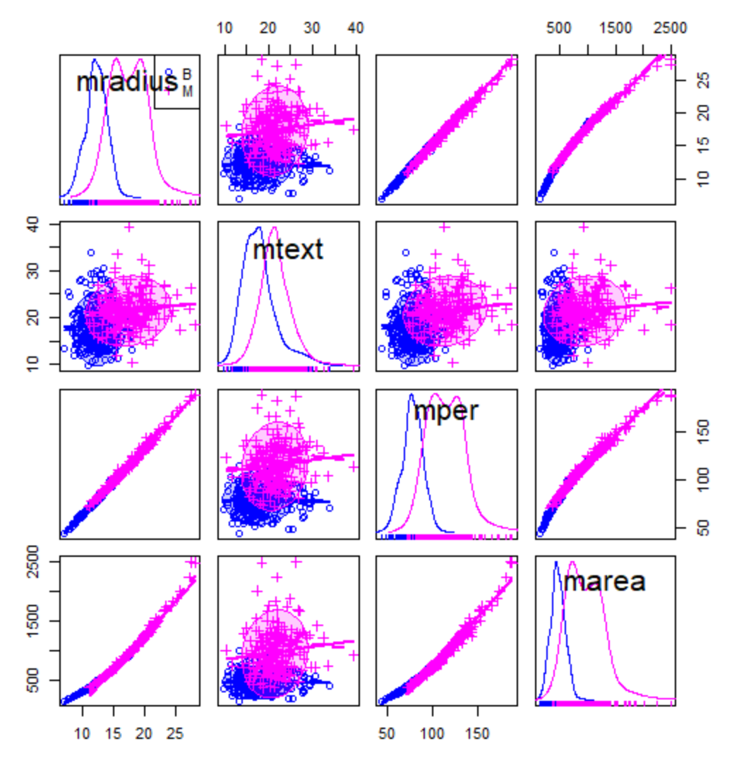
Scatter Plot Matrix
For example, the relationships between the first 4 features:
There seems to be severe linear relationships between the following features:
mean_radius and mean_perimeter
mean_radius and mean_area
mean_perimeter and mean_area

Slide 6
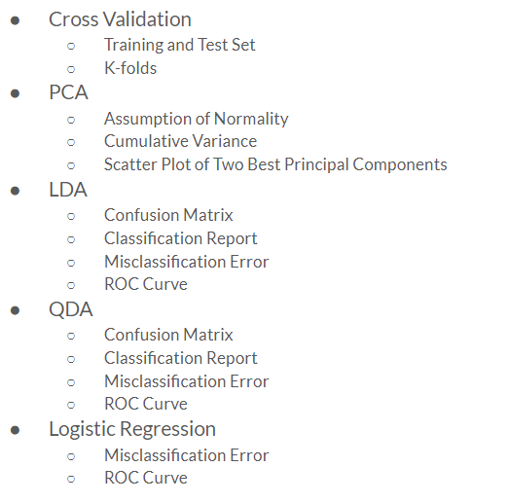
Methods
Cross Validation
Training and Test Set
K-folds
PCA
Assumption of Normality
Cumulative Variance
Scatter Plot of Two Best Principal Components
LDA
Confusion Matrix
Classification Report
Misclassification Error
ROC Curve
QDA
Confusion Matrix
Classification Report
Misclassification Error
ROC Curve
Logistic Regression
Misclassification Error
ROC Curve

Slide 7
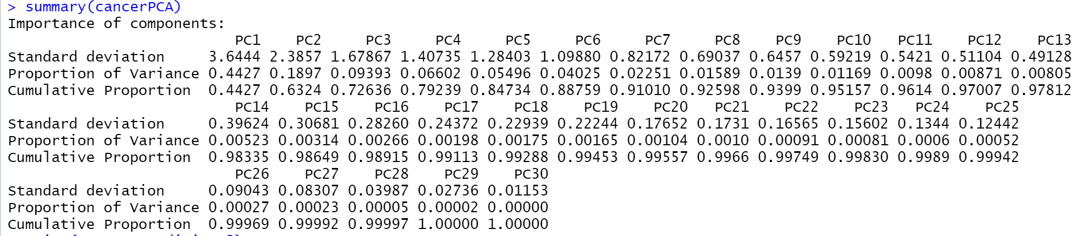
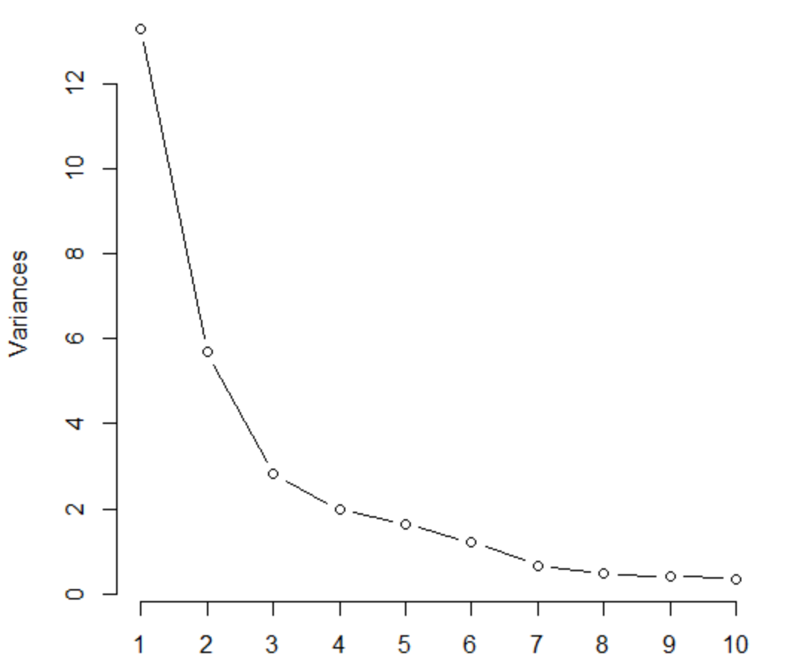
Principal Component Analysis
Let’s look at the summary first:
The first 7 PCs can explain over 90% of total variances of the original data.
The first 17 PCs can explain over 99% of total variances of the original data.

Slide 8
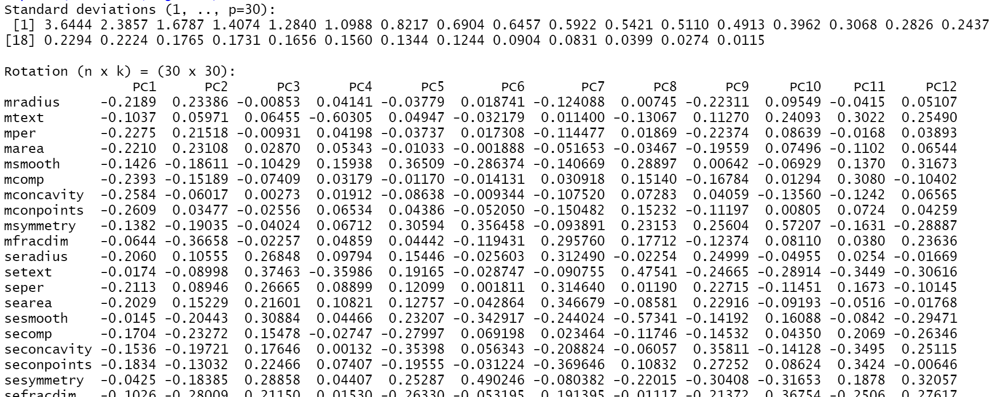
Standard Deviations and Rotation (part)

Slide 9
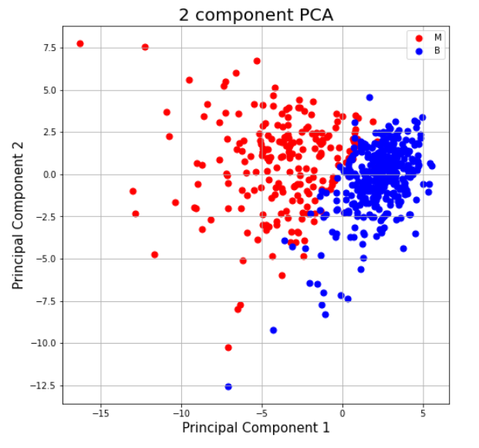
Scatter Plot for PC1 and PC2

Slide 10
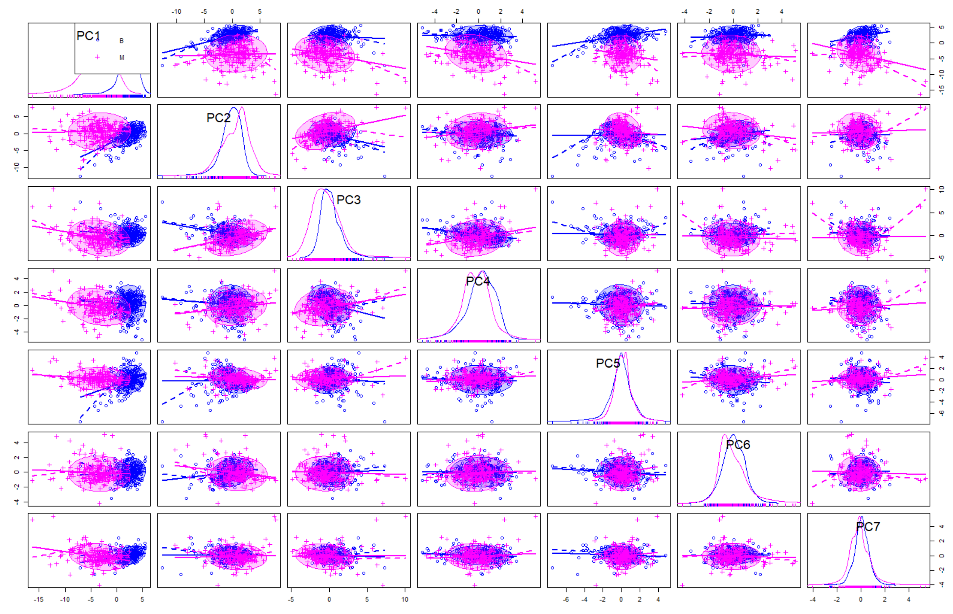
Scatter Plot Matrix for PC1 to PC7

Slide 11
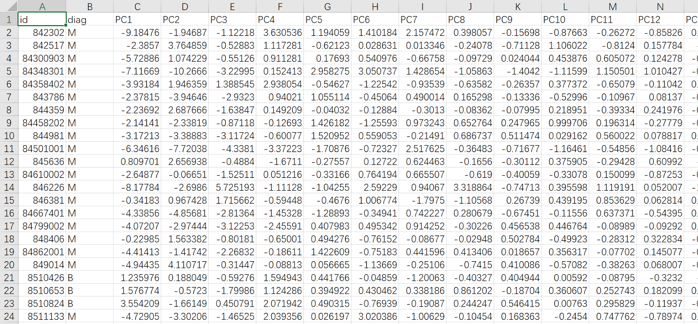
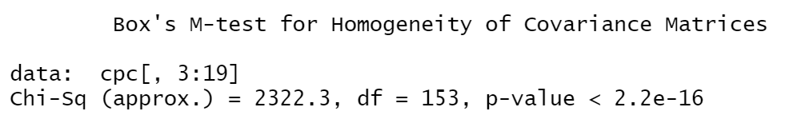
PCA data (part)
Box’s M test for covariance matrices:
diag=M to diag=B

Slide 12
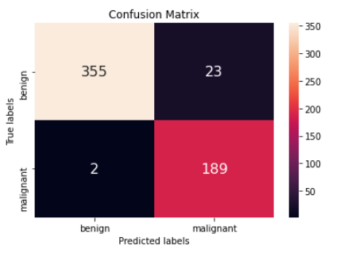
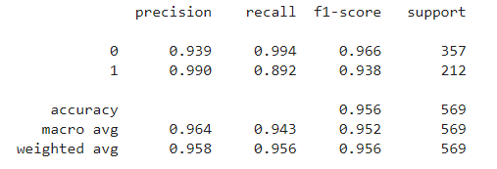
LDA Confusion Matrix and Classification Report
Very few false negative and false positive observations
High precision, recall, and f1-score for each class
High accuracy -> .956

Slide 13
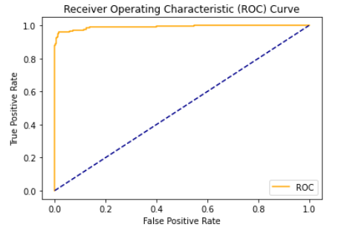
LDA ROC Curve
AUC of ROC Curve: .992

Slide 14
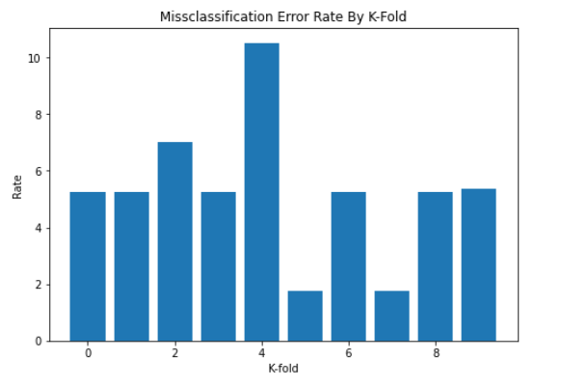
LDA Misclassification Error Rate
Overall Misclassification Error: 5.263%
Misclassification error rate appears to be consistent among most of the folds.

Slide 15
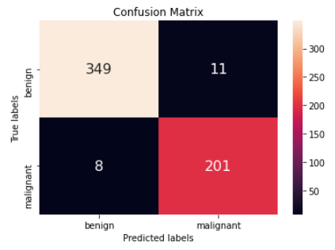
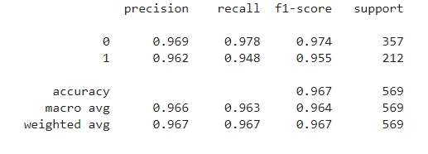
QDA Confusion Matrix and Classification Report
Higher accuracy than LDA
More false negatives and less false positives than LDA

Slide 16
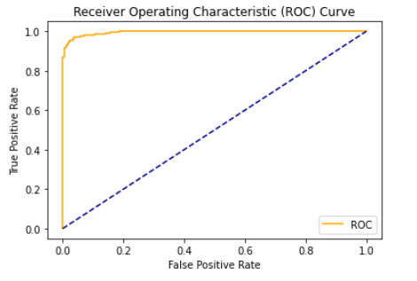
QDA ROC Curve
AUC of ROC Curve: .995

Slide 17
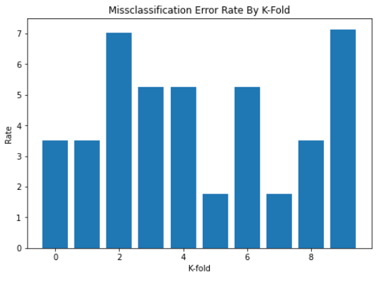
QDA Misclassification Error Rate
Overall Misclassification Error Rate: 4.398%

Slide 18
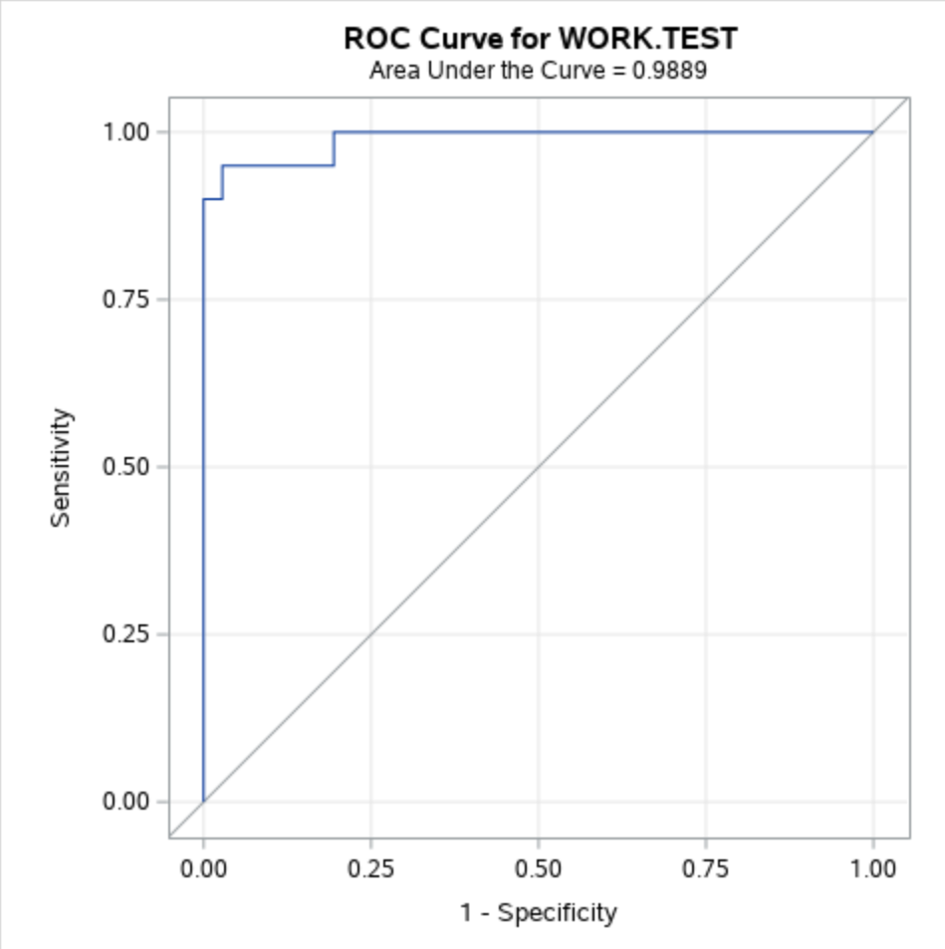
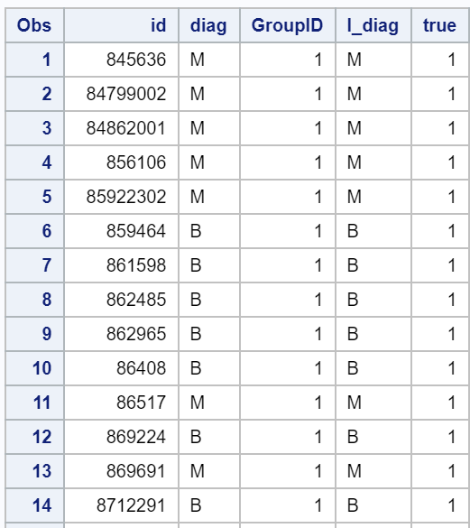
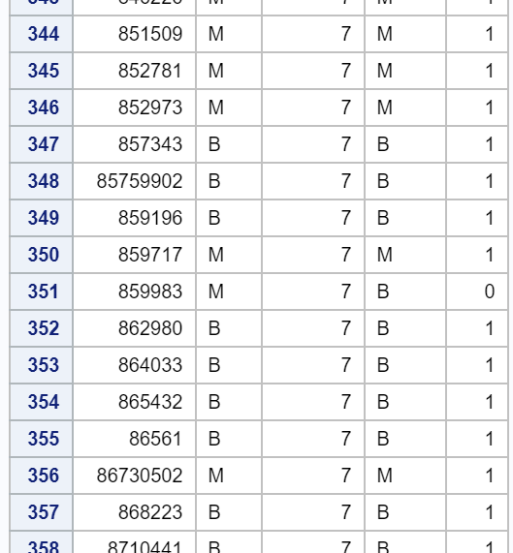
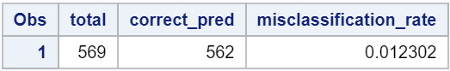
Logistic Regression w/ 10 Fold CV
We conduct the logistic regression using SAS. The logit link function of PC1 to PC17 is used.
After 10 times training and testing, we combine the 10 test groups together and count the numbers of right and wrong.
Then we get the misclassification rate 0.012302

Slide 19
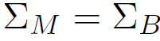
Verdict: LDA vs QDA vs Logistic Regression
Logistic Regression has the lowest misclassification rate and the highest accuracy.
Misclassification rate of LDA: 0.05263
Misclassification rate of QDA: 0.04398
Misclassification rate of Logistic Regression: 0.012302
Again from the boxM test, the covariance matrix of the 2 groups are not the same. Since LDA has the assumption of while QDA doesn’t, it’s no surprise that QDA has better performance than LDA.

Slide 20
Thank you
Q&A

